Slide 1
The use of social networks to improve engagement and implement a research-led curriculum
Dr. Sofia Izquierdo Sanchez Department of Economics University of Manchester | Dr. William J. Tayler Department of Economics Lancaster University
DEE 4-5 September 2023, Heriot-Watt University

Slide 2
What will we talk about today?
The use of social networks as a way of
Introducing research-led teaching activities;
Increasing engagement
Relating teaching to students’ real lives.
We introduced an Instagram page (@dailylifeecon) to complement the learning experience of students in various economics modules at the University of Manchester and Lancaster University.
Using posts, reels (short videos up to 90 seconds), and stories (posts available for 24 hours), we engaged the students ahead of the lecture trying to attract their attention and motivate them to increase engagement.
We linked the content to case studies and/or academic papers promoting an active research-led curriculum, and, complementary to academic teaching, we outreach economics to the general public.

Slide 3
A shift to blended learning
The impact of the Covid-19 pandemic on traditional university learning
66% of students prefer blended learning
Disengagement from students
Integration of research in higher education has positive results in student motivation and final grades (Boyer, 1990; Kinkead; 2003; Land and Gordon, 2013).
The optimal combination between teaching and research-led teaching (Griffiths, 2004; Haaker and Morgan-Brett, 2017; Healey and Jenkins, 2009; Pfeiffer and Rogalin, 2012; Zamorski, 2002).

Slide 4
Relationship between student satisfaction and research intensity (2008-2021)

Slide 5
The use of social networks in higher education
The benefits of the use of social networks in academia have been demonstrated for both, students and academic (Nandez and Borrego , 2013; Meishar-Tal and Pietersen, 2019).
They have been used to increase engagement, self-learning, as large case discussions platforms, or to promote collaborative learning (Al-Balhrani and Patel, 2015 and 2017; Dabbagh and Kitsantas, 2012; Deng & Yuen, 2010; George, 2011; Guy, 2012; Junco et al., 2010; Jones and Baltzersen, 2017; Middleditch et al., 2022)
We study the use of Instagram to relate academic content to students' real lives.
Our approach aims to connect research-led teaching activities, engagement enhancement, and real-world relevance through reels, posts, and case study repositories.
This aligns with Generation Z's affinity for Instagram as a valuable educational tool.

Slide 6
How much Generation Z uses Instagram

Slide 7
Introducing the Instagram Approach @dailylifeecon
For the Academic year 2022-2023 we introduced an Instagram page (@dailylifeecon) as a complementary tool for students learning in the modules:
Principles of Microeocnomics 2 (1st year, University of Manchester);
Managerial Economics I (2nd year University of Manchester);
Microeconomics 4 ( 2nd (and some 3rd )year University of Manchester);
Monetary Macroeconomics ( 3rd Year, Lancaster University).
The three modules were taught in the economics programmes of their respective university, however students from different degrees could take some of these modules as optional.

Slide 8
Engagement

Slide 9
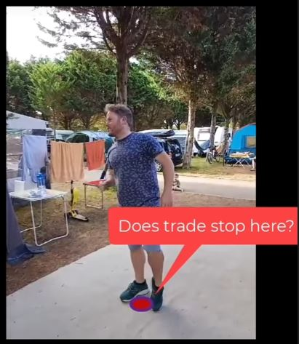
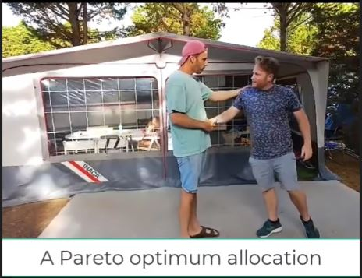
Case Study 1: Content linked to case studies
“Did you know that the Edgeworth Box is a powerful tool used to showcase how exchange between two individuals can boost one person's well-being without hurting the other? This leads to a win-win situation, enhancing overall social welfare from a given set of resources! It's all about that Pareto improvement – making everyone better off without making anyone worse off! During our summer break at a campsite in Spain, we can illustrate the basics of the Edgeworth Box, shedding light on the fascinating world of general equilibrium theory! Let's dive into the world of economics while soaking up the sun and learning something new! Are you ready to unravel the mysteries of the Edgeworth Box with us? For economists or those curious minds who will like to know more, you can access a full case study in the case studies bank (link available in bio)”

Slide 10
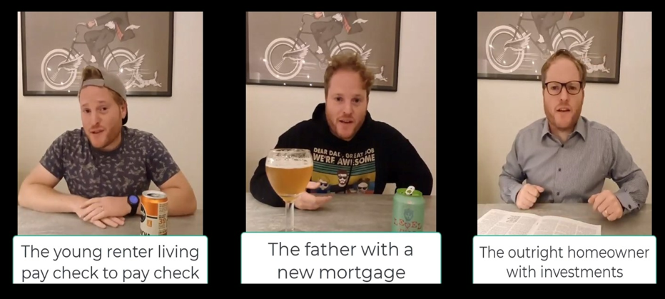
Case Study 2: Content linked to academic papers or articles
“A young renter living pay check to pay check, a father with a new mortgage, and an outright homeowner with investments enter into a bar…do you want to know how the increase in interest rates are affecting them?
A reel based on “How the Bank of England’s interest rate hikes are filtering through your finances” by William Tayler (Lecturer at Lancaster University) at The Conversation
On the 22nd of September, the Bank of England will decide whether to increase again the interest rates…but that’s a conversation (or a reel) for another day”

Slide 11
Impact on students and performance
We collected data on followers and their interactions per post and studied whether engagement with the Instagram account influenced the student’s final mark.
On average 12% of the students were following the account, however, the students could interact independently of being a follower. We find that being a follower doesn’t translate into actively engaging with the content. 34% of the students engaged with the account on a regular basis.
We use an OLS regression to analyse the effect that either being a follower or interacting with the account have on the student’s final mark. We then study whether being a follower or actively engaged with the account has an effect on the probability of failing or getting a mark above 60.

Slide 12
Instagram engagement and final marks
 | (1) | (2) | (3)
VARIABLES | Final mark | Probability fail | Probability above 60
Follower | 3.284*** | -0.525 | 0.246
 | (1.197) | (0.429) | (0.156)
Number of interactions | 0.224*** | -3.522*** | 0.0372*
 | (0.0668) | (0.136) | (0.0208)
Constant | 65.83*** | 1.487*** | -0.778***
 | (0.628) | (0.0923) | (0.0662)
Subject fixed effects | YES | YES | YES
University fixed effects | YES | YES | YES
 | (2.031) | (0.274) | (0.179)
Constant | 65.92***
 | (0.629)
Robust s.e | YES | YES | YES
Observations | 978 | 978 | 978
Note: Standard errors in parentheses *** p<0.01, ** p<0.05, * p<0.1. The dependent variable in Column 1 is the final mark of student i in subject j. The dependent variables in column 2 and 3 is a categorical variable which takes value 1 if the final mark of a student is less than 40 or higher than 60, respectively; and 0 otherwise.

Slide 13
Students Feedback
Opinion | Percentage of students
Understanding complex concepts | 62%
Making concepts relevant to real-life | 69%
Approachability or engagement | 69%
Creative or refreshing | 77%
I will share the content with friends | 54%
Good opportunity for feedback | 46%

Slide 14
Some insights
Integration of social networks for research-led teaching.
Instagram as a tool for engagement and real-life connections.
Positive correlation between engagement and final marks.
Feedback highlighting improved comprehension and engagement.
The presented study addressed this challenge by creatively leveraging Instagram to bridge the gap between research and student engagement.
Outreaching economics

