Slide 1


Lavinia Moldovan
(Mount Royal University)
Ramin Nasshei
(University College London)

Slide 2
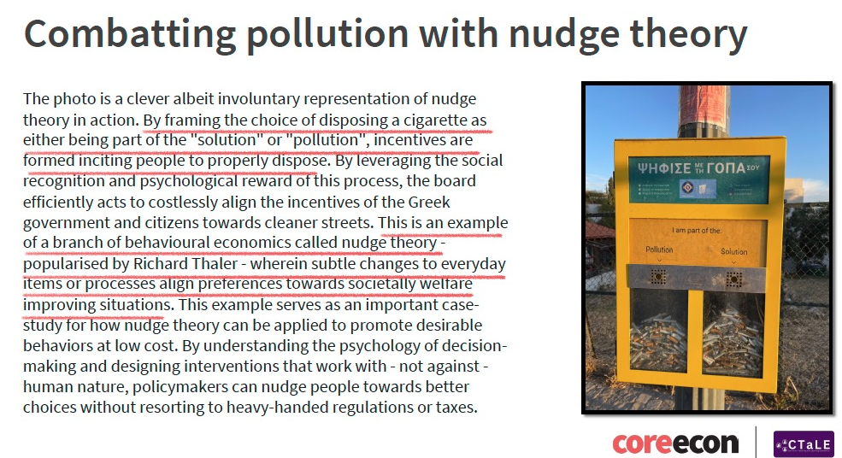

Slide 4
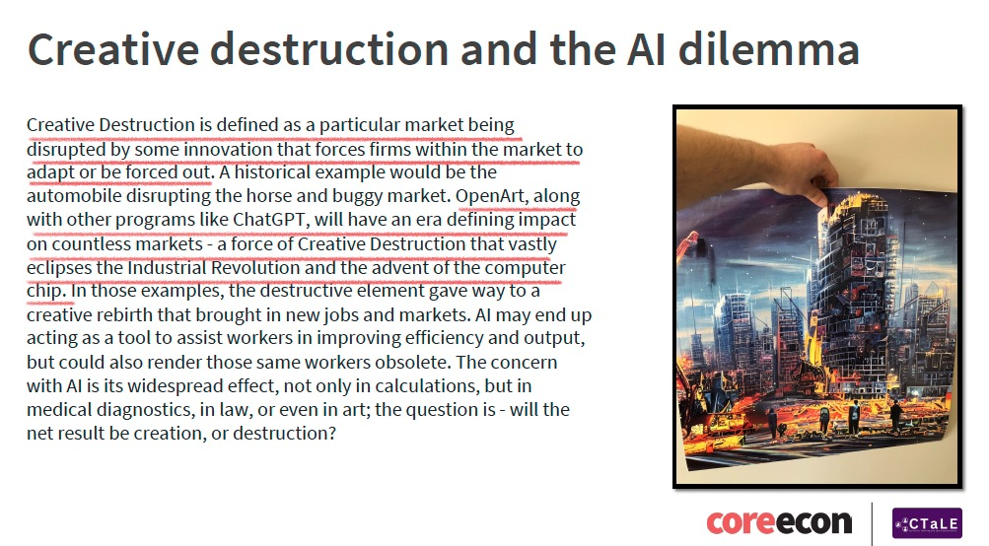

Slide 6
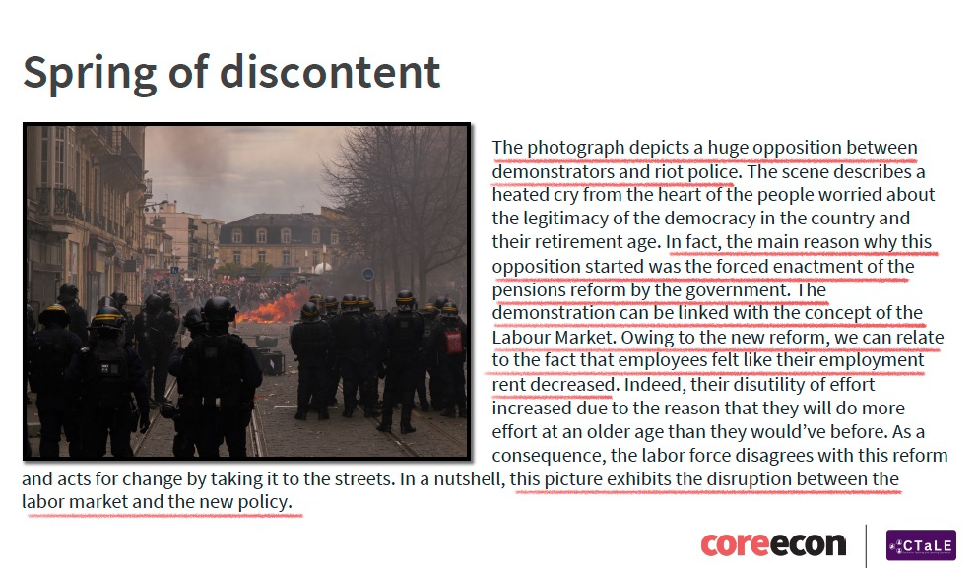

Slide 8
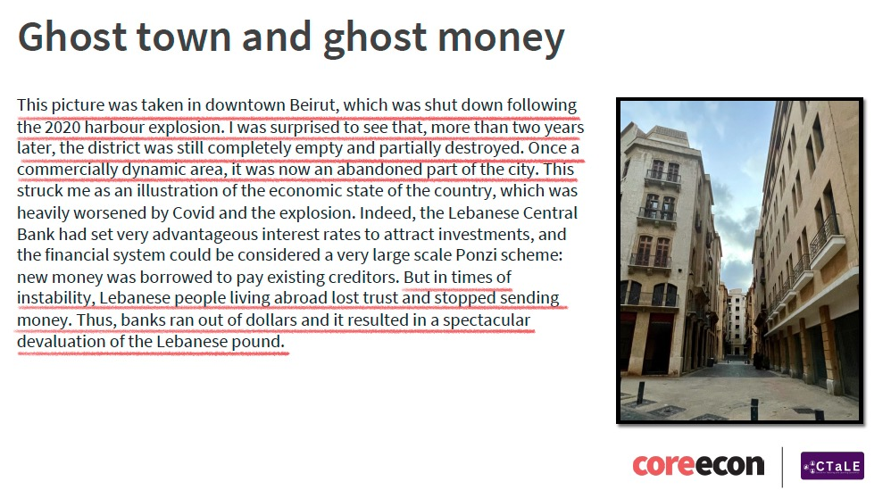

Slide 10
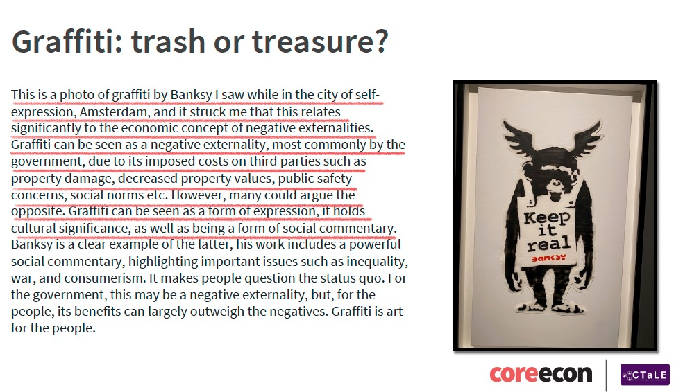

Slide 12
Photo, title, abstract
High school, UG
CORE Econ book concepts
Assessed or extracurricular

Slide 13
44 University Submissions
36 High School Submissions
Europe, Canada, UAE, South Korea, South Africa, India, Singapore

Slide 14
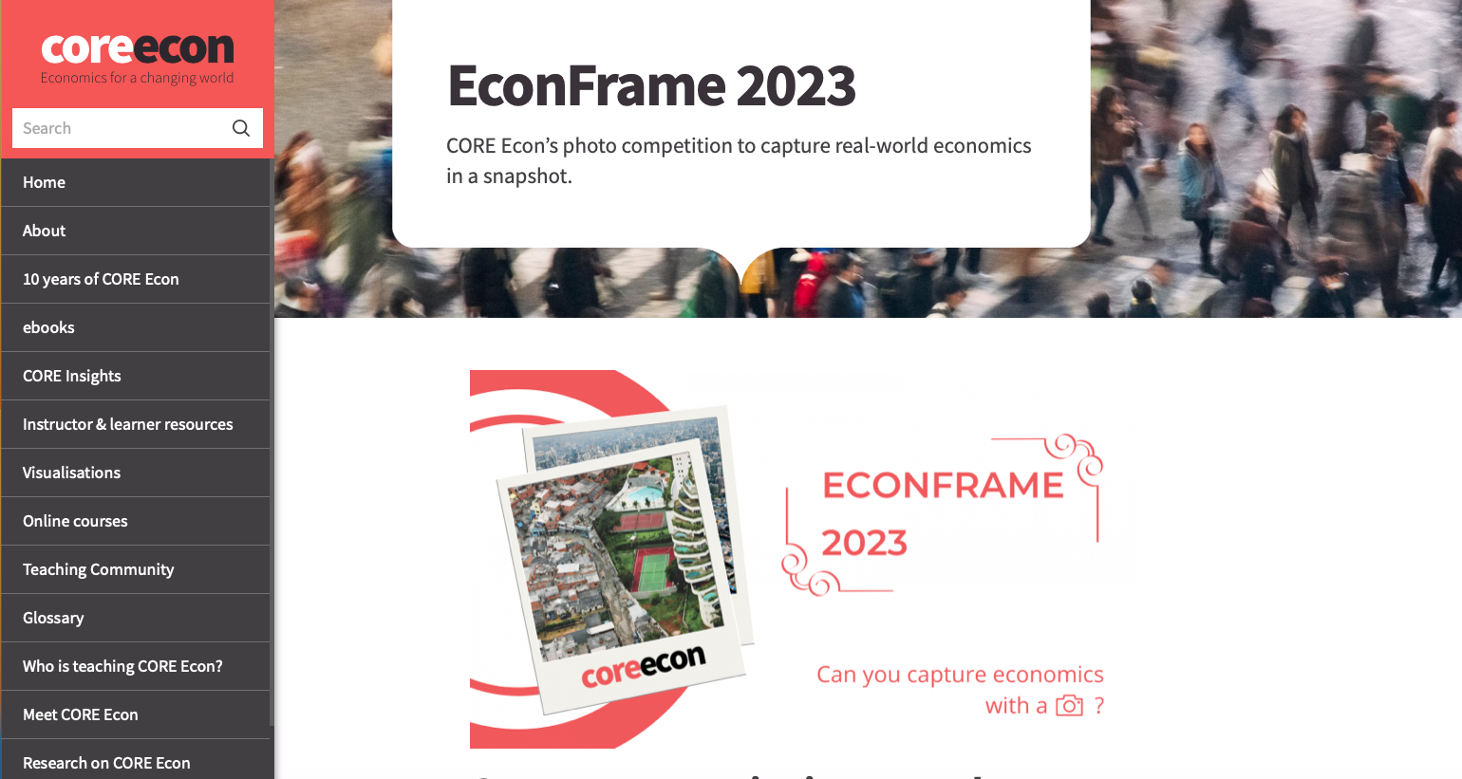

https://www.core-econ.org/econ-frame-2023/

