Slide 1
Student Expectations of Assessment and Feedback
Linda Juleff, Sam Ling and Becky Stone
Southampton Solent University

Slide 2
Introduction
Two year project involving level 4/5 students on 8 courses in 2013-14 and 10 courses in 2014-15
Designed to provide insights into student expectations across the 6 NSS areas:
Teaching and Learning
Assessment and Feedback
Academic Support
Organisation and Management
Learning Resources
Personal Development

Slide 3
Purpose
To identify what students expect
To identify differences between what we provide and what students expect
To align provision and expectation where feasible and desirable
To raise NSS scores by aligning expectations to activities

Slide 4
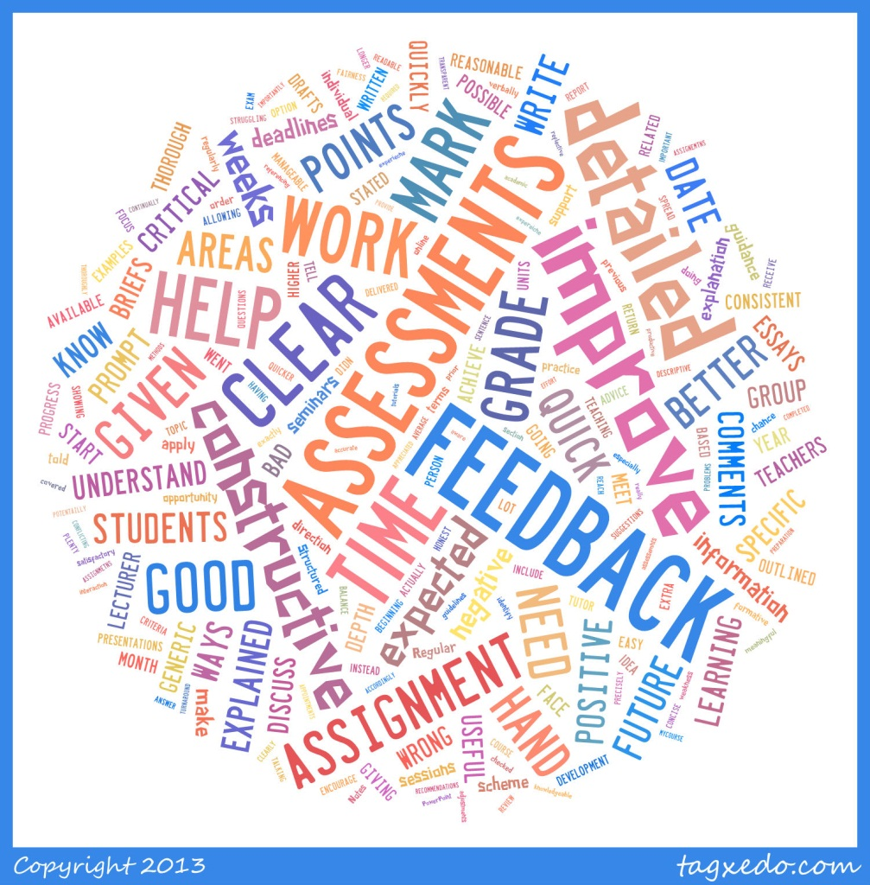
Assessment and Feedback 2013-14

Slide 5
Key findings 2013-14
Students Expect:
Feedback to be thorough and to highlight the good, and weak points of an assessment, providing advice on how to improve for future work.
Engagement in a dialogue about their work
Lecturers to co-ordinate with each other. Seen as key to consistency of marking & balanced scheduling of assessments

Slide 6
Assessment and Feedback 2014-15

Slide 7
Students’ Expectations of Assessment
Assessments should be:
Clear
Varied
Relevant
Practical
Engaging
Interesting
Individual
Explained in detail
Easy to understand
Assessed by clear assignment criteria
Given out in advance
Accurate with correct dates and details of how to submit

Slide 8
Students’ Expectations of Feedback
Feedback should be:
Clear
Honest
Timely
Legible
Detailed
Personal
Private
Constructive
High quality
Face to face
Fair and consistent
Positive and negative comments
Giving details of how to improve

Slide 9
Student Comments - Feedback
“Would like the lecturers to give clear Feedback whether it be positive or negative so I can develop it accordingly”
“A detailed account of what we did and didn’t get marks in order for us to further our assessment writing”
“Prompt, tailored to individual needs”
“All good here! Structured and usually on time, consistency!”

Slide 10
Conclusion
Students are quite consistent in their expectations of assessment and feedback and what will help them to learn.
Clarity in terms of assessment briefs and feedback is a key requirement
Variety and relevance was seen as important in relation to assessment
Feedback should be constructive and personal

