Slide 1
Does Formative Feedback Help or Hinder Students? An Empirical Investigation
2015 DEE Conference
Carlos Cortinhas, University of Exeter

Slide 2

Motivation for the study
In the 2012/13 academic year, I introduced my first year statistic students to weekly, formative, homework tasks. These tasks where designed to be completed online, allowing students to get immediate feedback on their work and get simple hints on where to investigate further if their answer was wrong. The main objectives of designing these tasks were :
  To allow students to apply what they were learning in lectures and tutorials
  To develop regular study habits in students
  To develop students’ critical thinking skills
  To further help students prepare for classes and tutorials
  To make Statistics more accessible and ‘fun’
After a large scale experiment over three years (with changes), I felt it was necessary to determine whether formative (non-compulsory) homework was effective in enhancing student learning or not.

Slide 3

The Issue
There is a vast literature in the pros and cons of homework…
The debate is very old (since mid-1800s) and the research mostly comes from the US – Gill and Schlossman (2003) and Gill and Schlossman (2004)
It is almost exclusively based on elementary and secondary school students
Topic of great controversy with the research to date being largely inconclusive - a number empirical studies claim to ‘prove’ both sides of the argument.
Almost generalized agreement that “too much”, “too often” homework is harmful but little agreement on what ‘too much’ or ‘too often’ is.
Significant national and cultural differences in the attitude towards homework appear to exist.

Slide 4

The Issue (II) – Key Lessons
Although not always clear, we can summarize some of the key findings of the research to date:
The link between homework and student achievement is not clear; some studies show positive effects (e.g. Trautwein (2007); Keith, Diamond-Hallam and Fine (2004), etc) while others show no or negligible effects - e.g. see Cooper (1989) for a survey
Homework seems to be more beneficial for older students – e.g. Cooper (1989), Hoover-Dempsey et al. (2001).
Students from low-income homes do not benefit as much from homework as students from high-income homes (i.e. homework amplifies inequalities) – Ronning (2011)

Slide 5
The Issue (III) – Key Lessons (cont.)
Homework might be beneficial in some subjects (Maths) but not others (Science, English, History) – Eren and Henderson (2011)
Asian American students may benefit more from Homework than other ethnic groups in the US – Keith and Benson (1992)
Of the (only) five (empirical) existing economic studies that examine the effects of homework on student outcomes, four focus on the US (Aksoy and Link (2000), Betts (1997), Eren and Henderson (2008) and Eren and Handerson (2011) and one on Holland (Ronning (2011). All focus on high school students.
This papers attempts to add to the existing literature by developing an empirical study on the effects of (formative) homework on student outcomes in a group of students taking a introductory statistics class in a university context.

Slide 6

Data
Data for this study:
All students taking BEE1022 – Introduction to Statistics in 2014/15 (580 students)
Students had to complete a total of 10 homework tasks over 11 weeks (VLE system). Tasks were mostly MCQs, most of which involved calculations before answering.
Deadlines for completion of each task were in place (about 10 days)
Homework was formative (non-compulsory) and as such did not count towards final grade
Students have the same lecturer and tutor so no need to control for unobserved teacher characteristics

Slide 7
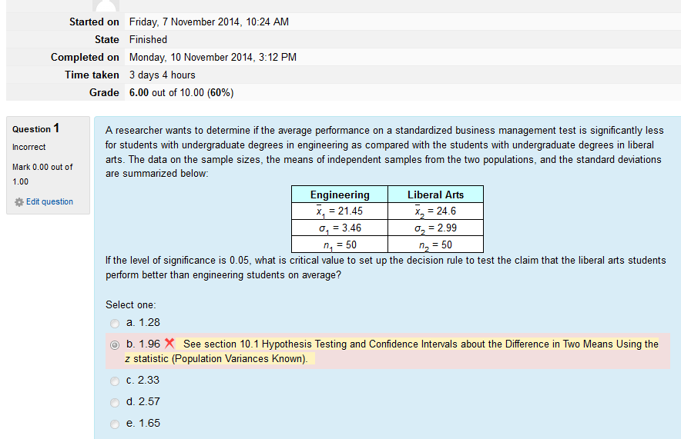
Data: Example of homework task

Slide 8
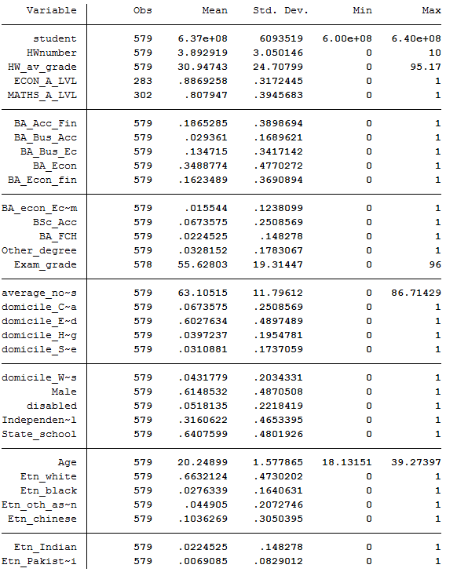
Data: Raw data

Slide 9
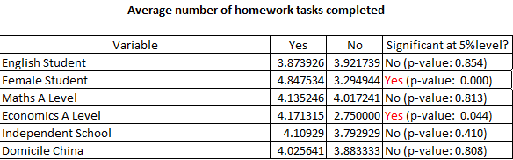
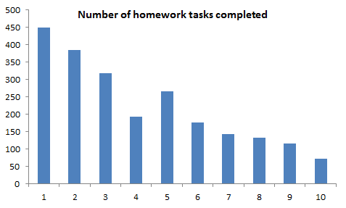
Data: Raw data

Slide 10

Empirical methodology
We assume that the impact of homework on the exam score (ES) of pupil i can be explained by the following simple education production function:
Where:
EG_{i} = Final Exam Grade for student i
HW_{i} = Average grade of 10 homework tasks completed by student i
x’_{i} = is a vector of observed student traits (including Nationality, Age, Gender, degree, whether student has A-level in Maths and/or Economics, ethnicity, etc.)
ε_{i} = zero mean, normally distributed error term.

Slide 11
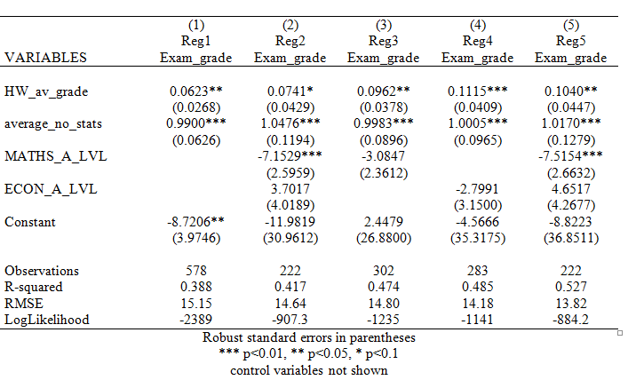
Results: Full Sample
where (1) to (5) are OLS equations that include a varying number of independent variables, from the simplest in (1) (one control variable) to the most complete in (5) which includes 24 control variables were included.

Slide 12
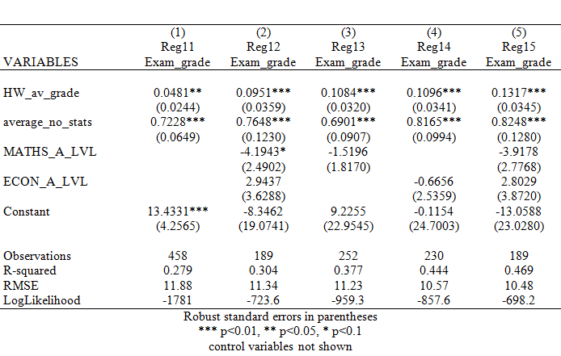
Results: Students with Exam ≥ 40
where (1) to (5) are OLS equations that include a varying number of independent variables, from the simplest in (1) (one control variable) to the most complete in (5) which includes 24 control variables were included.

Slide 13
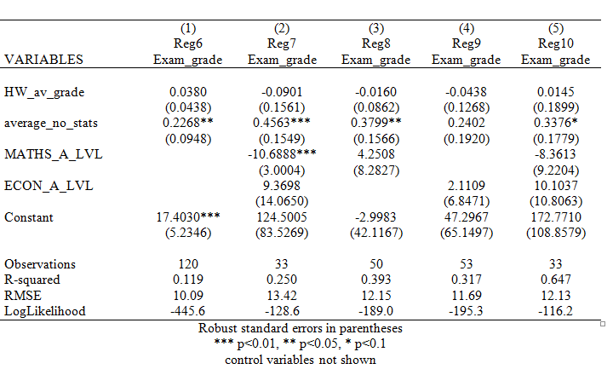
Results: Students with Exam < 40
where (1) to (5) are OLS equations that include a varying number of independent variables, from the simplest in (1) (one control variable) to the most complete in (5) which includes 24 control variables were included.

Slide 14

Final Remarks
This paper is still work in progress. The main result is that it shows that completing online formative homework tasks contributes to higher grades even after controlling for student characteristics and ability/effort but only for good students.
  This result suggests that formative homework might contribute to amplify inequalities amongst students and other strategies are needed to close the gap
No evidence (not reported here) was found that gender, ethnicity, disability, age, type of secondary school affect exam outcomes.

